Slide 1
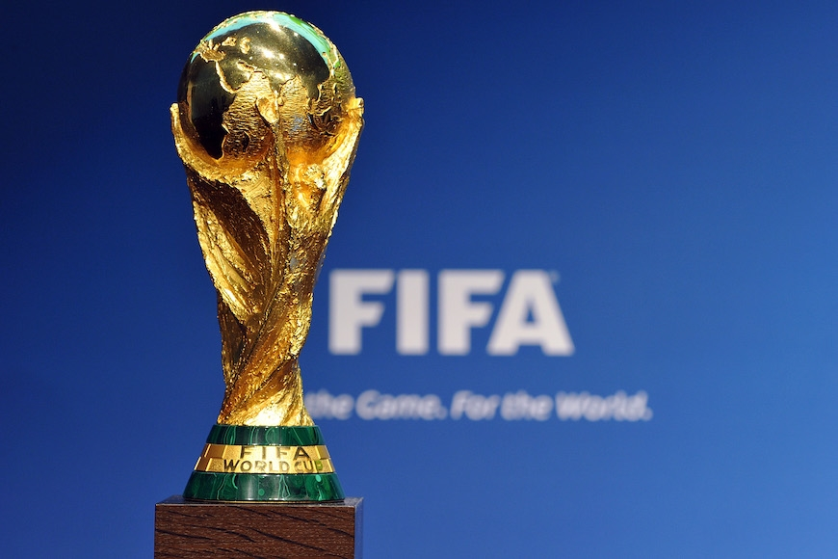
BRAZIL
Brazil’s performance throughout World Cups
Present by : Nhat Phuc, Data Science Class, Coderschool

Slide 2
Main contents
1
Brazil’s Win – Loss Record in the World Cups
Brazil Goal Scored and Conceded in the World Cups
2
Brazil’s performance in difference stage of the World Cups
3

Slide 3
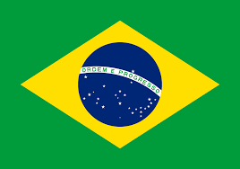
Overview
5
20
104
67%
221
102
Champion
Attend
Match
Brazil has 5 times won the World Cup
Brazil has 20 times attend in the World Cup (1930 – 2014)
Brazil has 104 matches through in World Cups
Win rate
Score Goal
Conceded
Brazil has 67 percent win in the World Cups
Brazil had 221 score goal in the World Cups
Brazil had 221 conceded goal in the World Cups

Slide 4
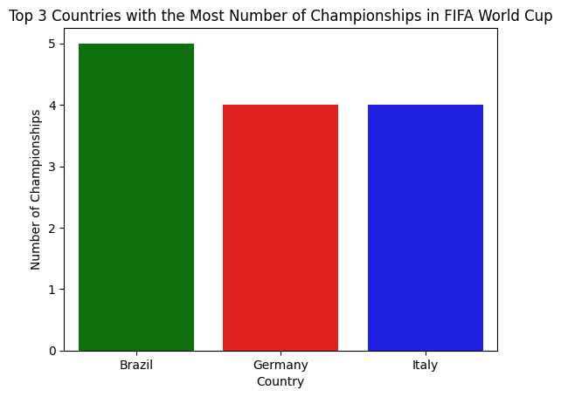
CHAMPION
Brazil has 5 times won the World Cups. Germany and Italia have 4 times won the World Cups

Slide 5
01
Brazil’s Win – Loss Record in the World Cups

Slide 6
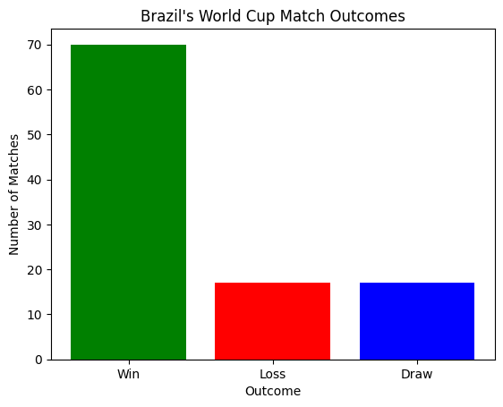
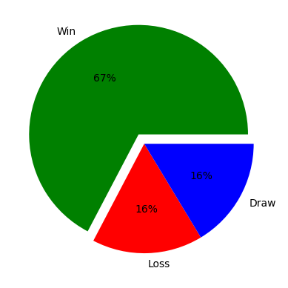
Brazil’s World Cup Match
Brazil has 70 wins, 17 draws and 17 losses through in the World Cups

Slide 7
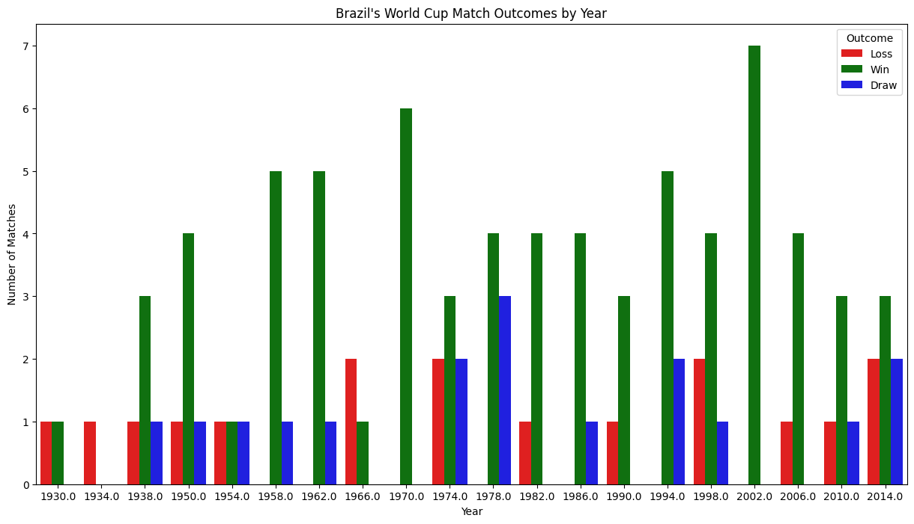
Brazil’s World Cup Match by Year
Brazil has won in 1958, 1962, 1970, 1994 and 2002. They were also the champion in these years.
Brazil weakened between 1974 and 1990

Slide 8
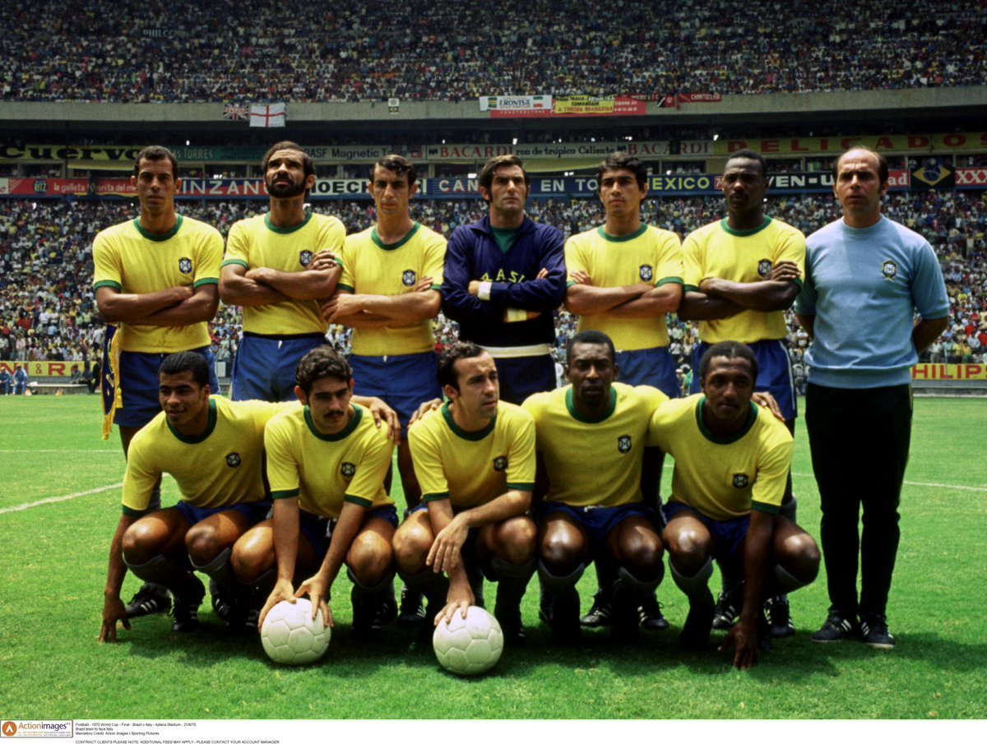
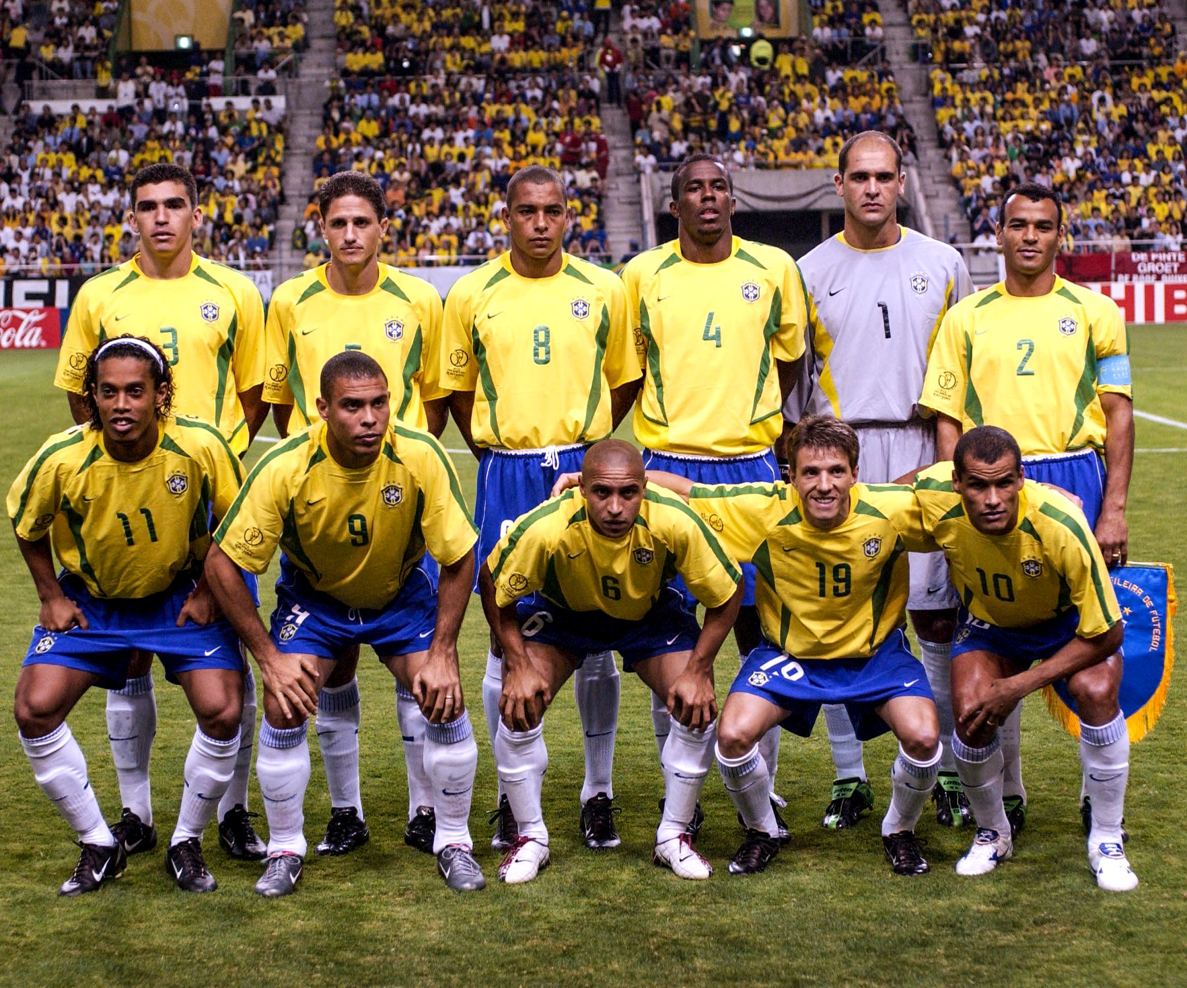
Dream team of Brazil
0s
player_brazil_1970.loc[player_brazil_1970['MatchID']==1770]['Player Name']
1970
2002
Marcos, Cafu , Lucio, Roque jr, Edmilson R Carlos Gilberto Ronaldo ,Rivaldo, Ronaldinho Juninho, Dida, Rogerio, Ricardinho, Belletti, Anderson, Kleberson, Junior, Denilson Vampeta, Edilson, Luizao, Kaka
Felix, Brito, Piazza, Alberto, Clodoaldo, Jairzinho, Gerson, Tostao, Pele, Rivelino, Everaldo, Antonia, Ado, Roberto, Baldochi, Fontana, Camargo, Cesar, Edu, Dario, Ze Mario, Leao

Slide 9
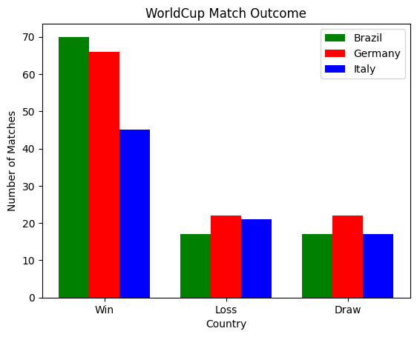
Compare with Germany and Italy
Brazil has the highest win rate (67%) and lowest loss rate (16%)

Slide 10
02
Brazil’s Goal Score and Conceded in the World Cups

Slide 11
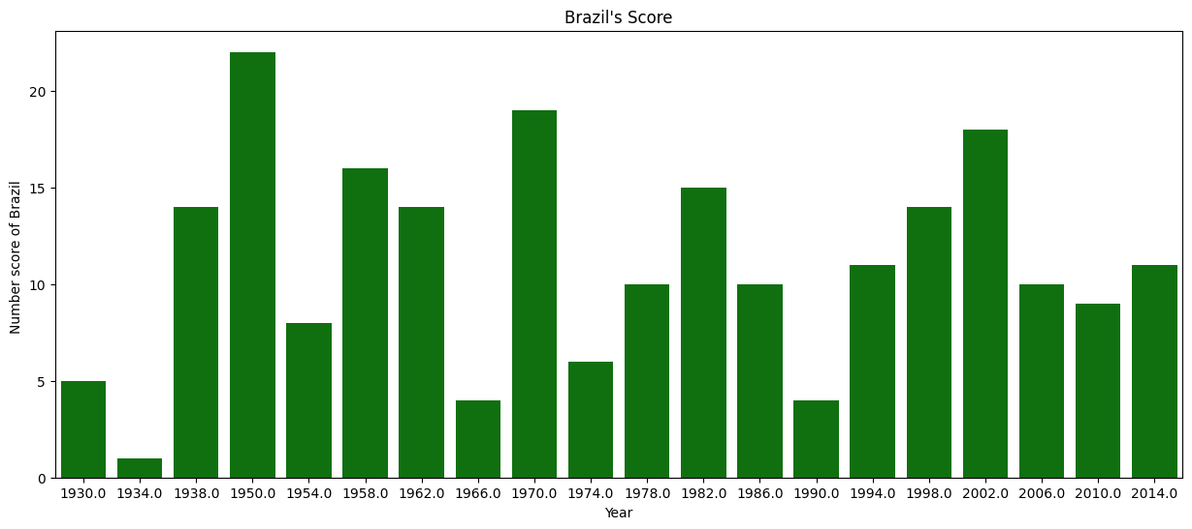
Brazil’s Score Goal
Brazil scored many goals in the 1950s, 1958, 1970, 1982 and 2002.

Slide 12
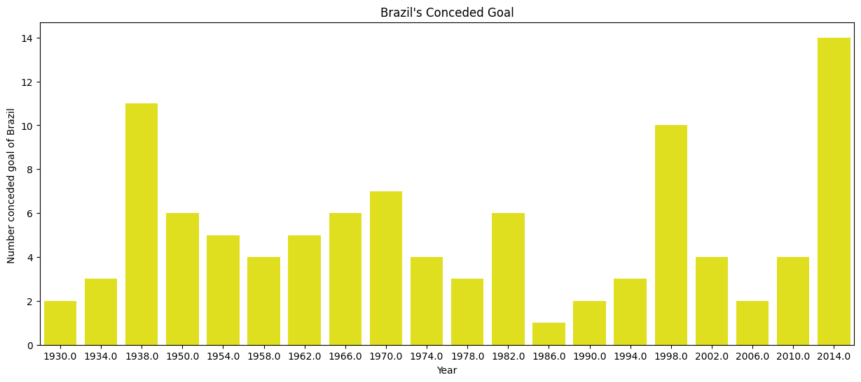
Brazil’s Conceded Goal
Brazil’s conceded many goal in the 1938, 1998 and 2014.
Typical is the 7-1 defeat when meeting Germany in 2014

Slide 13
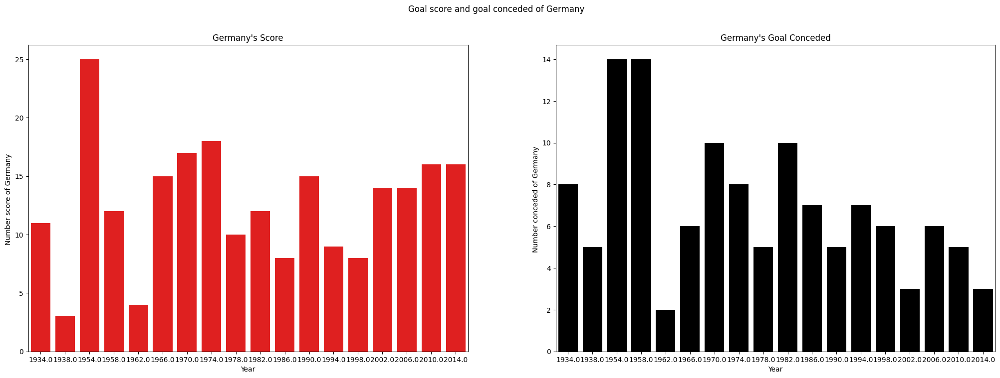
Germany’s Scored and Conceded Goal
Notes:
Đức vô địch vào các năm 1954, 1974, 1990, 2014

Slide 14
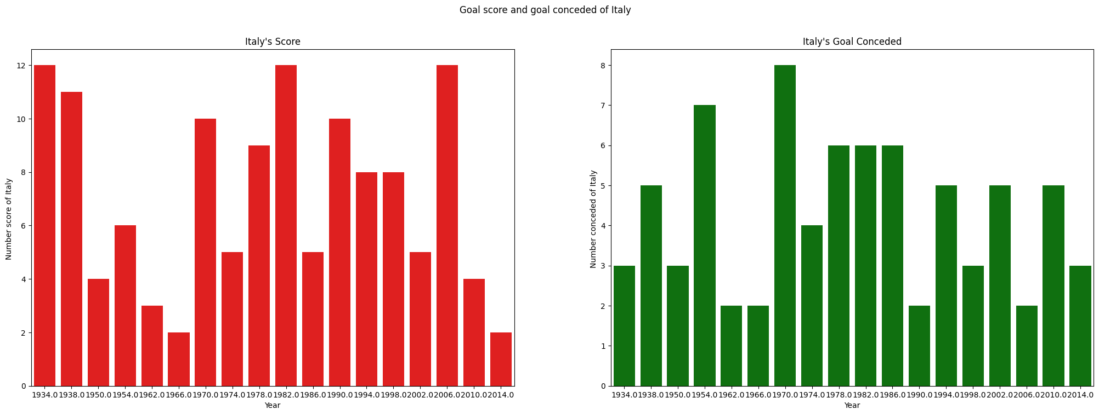
Italy’s Scored and Conceded Goal
Notes:
Ý vô địch các năm 1934, 1938, 1982, 2006

Slide 15
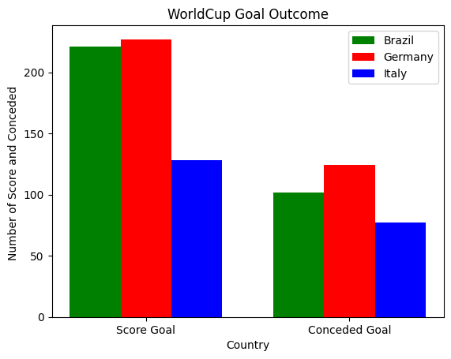
Compare with Germany and Italy
Brazil’s has almost as many goals as Germany but Brazil’s conceded goal less than Germany
Italy has the least number of goal conceded in 3 countries

Slide 16
03
Brazil’s performance in difference stage of the World Cups

Slide 17
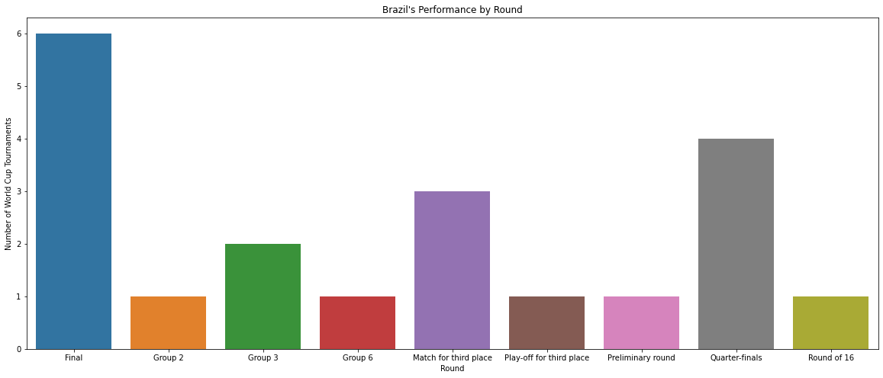
Brazil’s Performance by Round

Slide 18
Win rate of Brazil
75%
62%
63%
Round of 16
Quarter Final
Semi Final
67%
Final

Slide 19
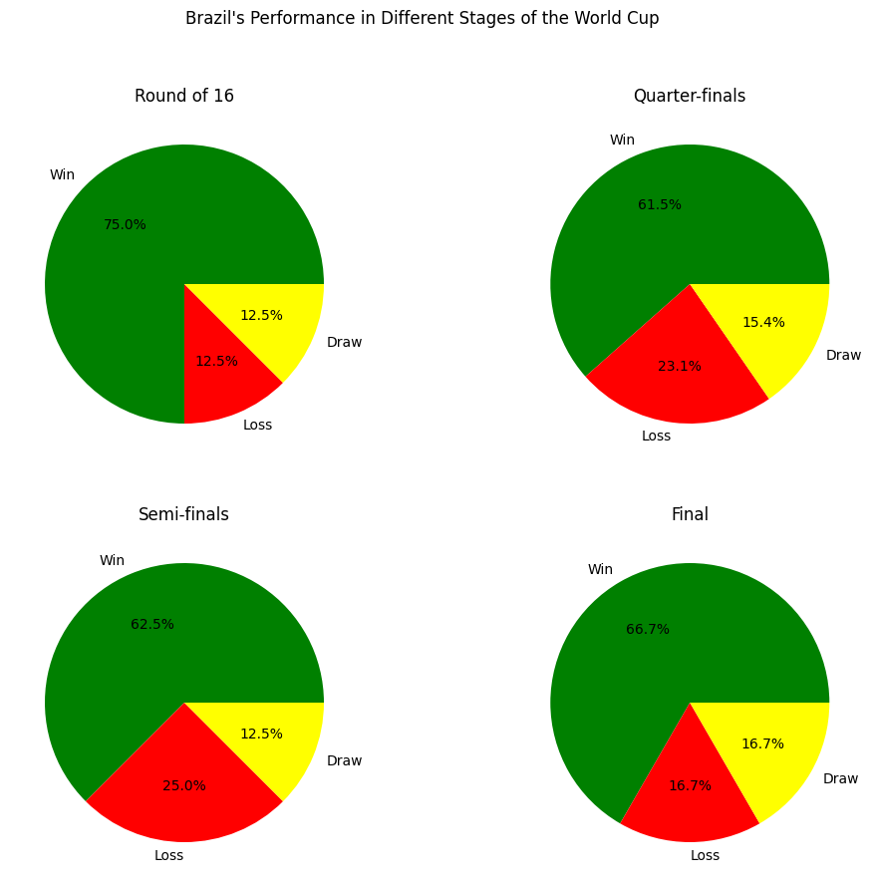
Brazil’s Performance in difference stages of the World Cups
Brazil has a high rate in knock out rounds
However, after the champion in 2002, Brazil still has not won another championship
Brazil has the most times in the knock out round of the World Cup.

Slide 20
Summary
Brazil maintains stability through world cups ( better than German and Italy)
Brazil has a strong attack and a relatively solid defence
We can hope for brazil's bright future in the next world cups if they maintain and improve their tactics like these past 20 tournaments

Slide 21
Thanks!
Do you have any questions?

